Slide 1
Top quark and tau lepton – what can two of the most massive elementary particles tell us?
Mikhail Arov, PhD

Slide 2
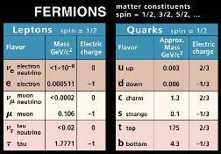
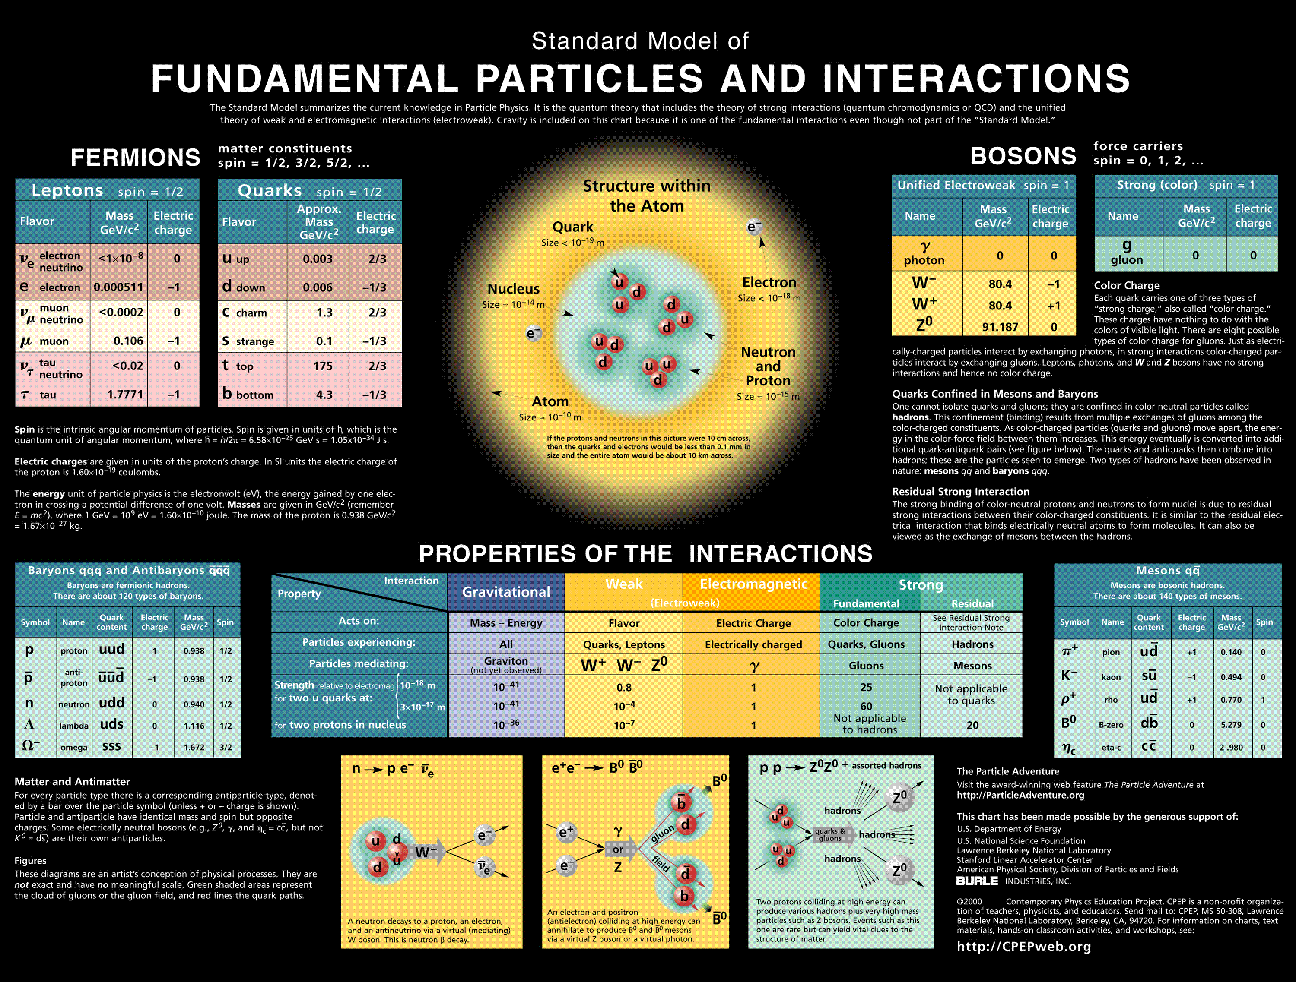
This poster hangs in (almost) every physics department !

Slide 3
How are the two related?
ν
τ⁺
b
W⁺
t
Is it the only possible decay of the top quark?

Slide 4
Of cause not!
ν
ν
e⁺
μ⁺
b
H⁺
b
?
H⁺
H⁺
W⁺
?
W⁺
t
Standard model
t
Standard model
j
j
b
H⁺
?
W⁺
t

Slide 5
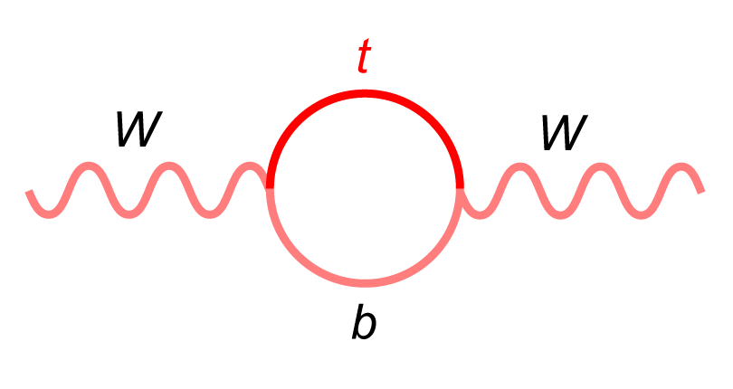
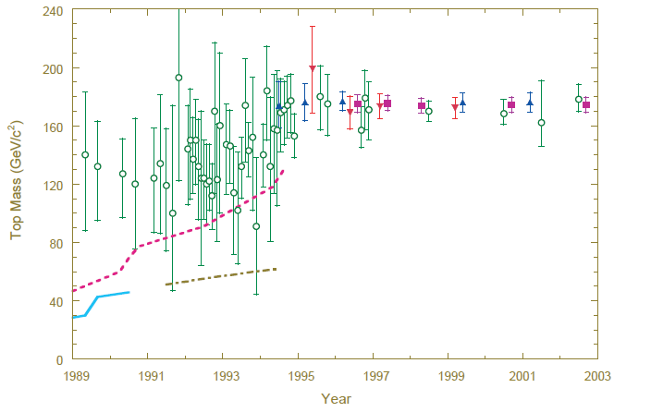
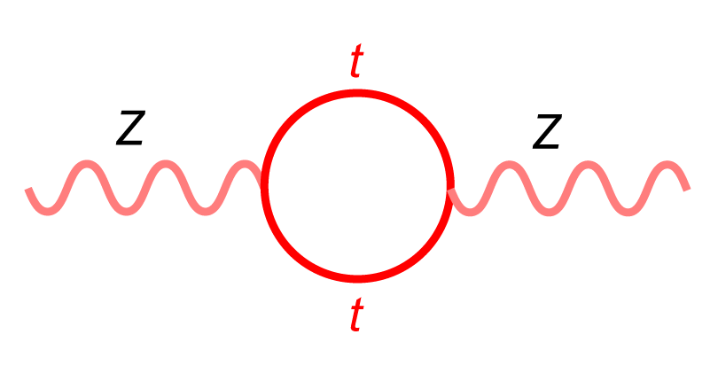

How can the top be reached?
Huge top mass uncertainties !

Slide 6
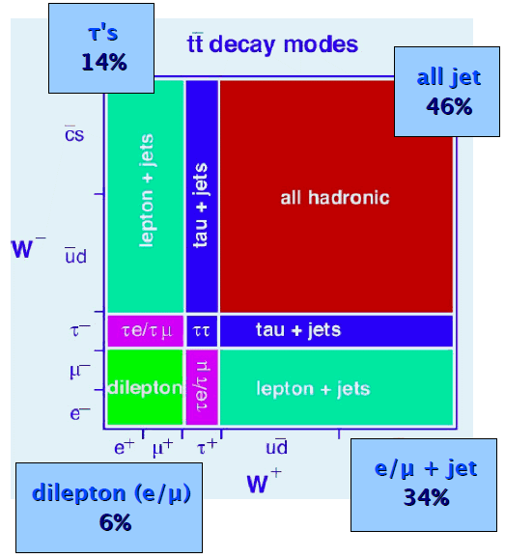
A better way!
W⁺
b
t
p
p
t
W⁻
b

Slide 7
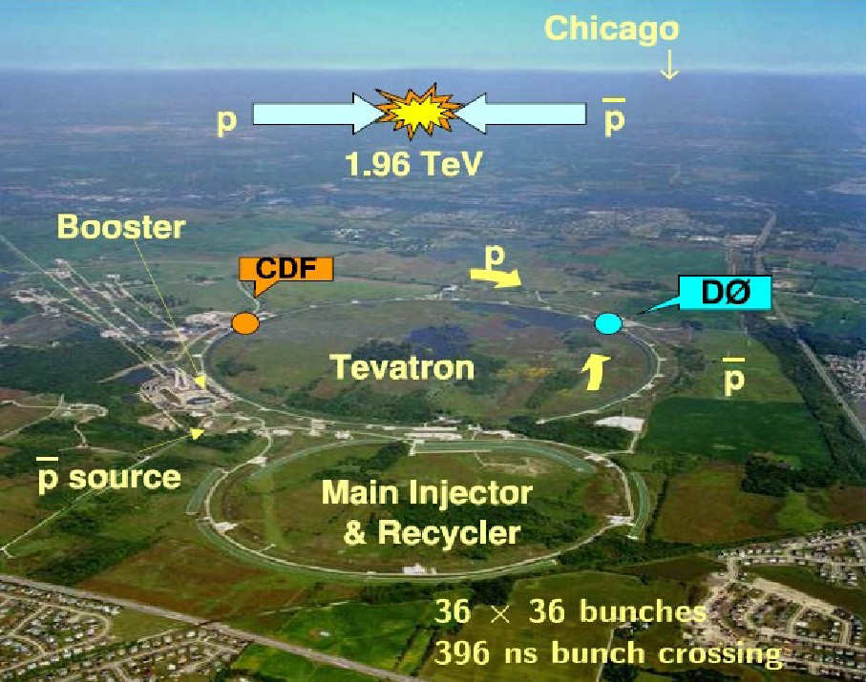

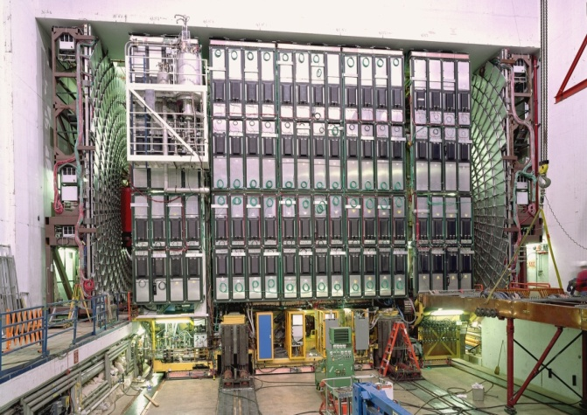
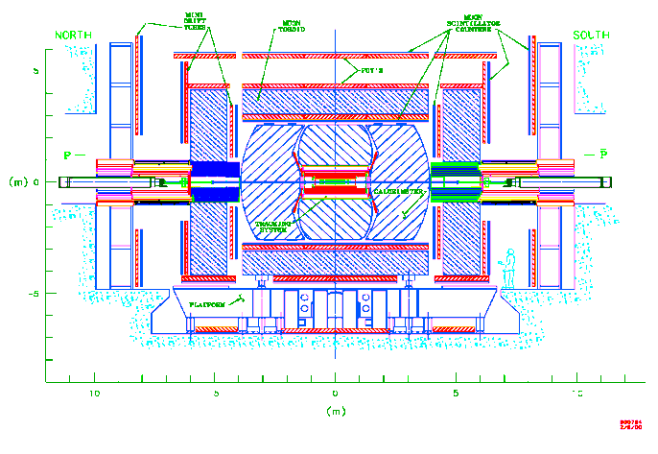
Tevatron collider at Fermilab
muon system
shielding
electronics

Slide 8
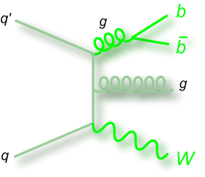
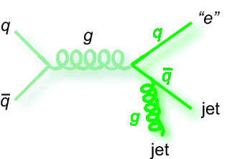
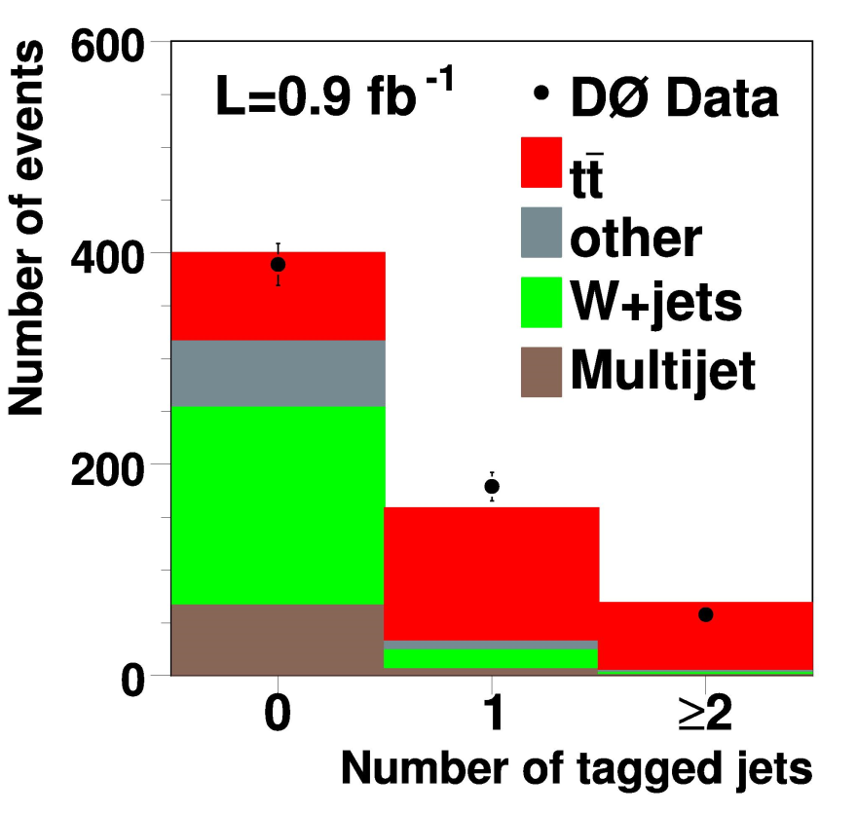
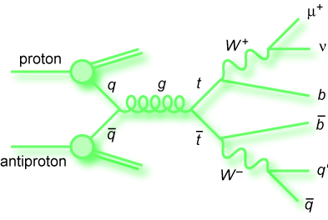
Top Background proceses
And methods to reduce them
B-tagging : Multijet has no b-jets
Missing E_{T} : Multijet has no neutrino
Other, more sophisticated techniques
Notes:
Add a per-btag plot -> motivate b-tagging

Slide 9
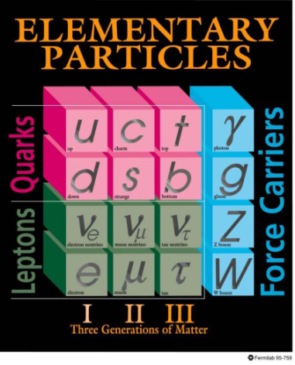
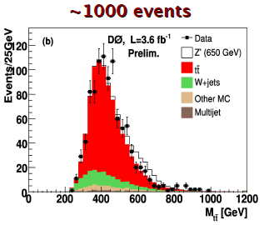
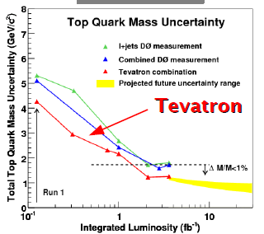
This is how top quark was discovered
Discovered in 1995 by CDF (19 events) and DO (17 events)
Since then we observed
Top quark mass is measured with <1% uncertainty

Slide 10
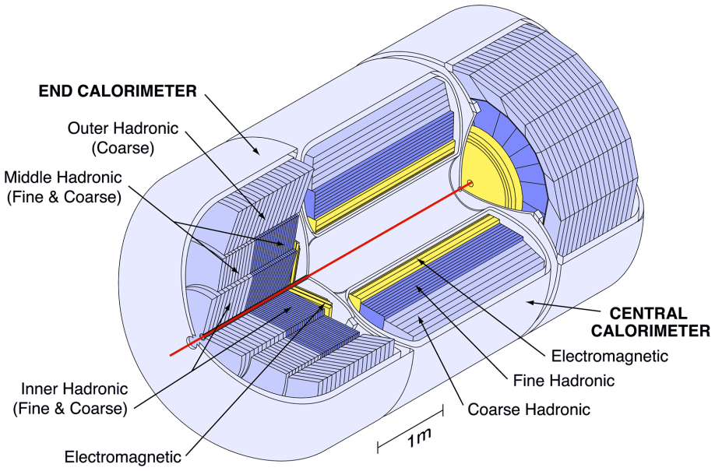
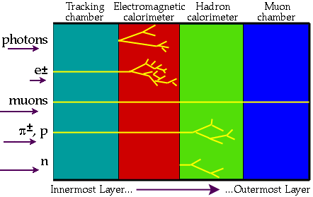
Particle detection
Where is τ?

Slide 11
τ reconstruction
All decay products tend to be constrained within narrow cones
But so are the jets!
Neural Net is trained to separate “good” τ candidates from jets
Type 1
Type 2
Type 3

Slide 12
Way of the tau
q
e
2 b jets
Hadronic τ
Missing E_{T}
2 light jets
M. Arov’s PhD Thesis
1 light jet and 1 lepton (e or μ)
H. Sumowidagdo’s PhD Thesis (M. Arov collaborator)
b
W⁺
ν_{e}
q
t
p
p
t
ν_{τ}
W⁻
b
Hadrons
τ⁻
ν_{τ}

Slide 13
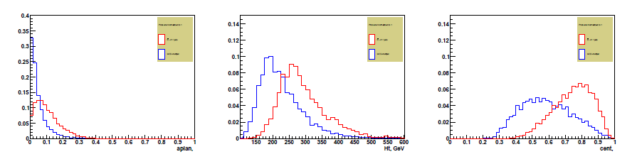
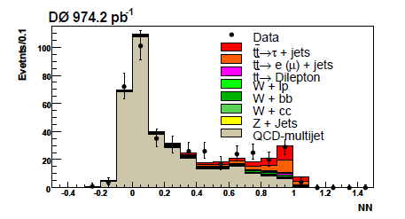
Artificial Neural Network again
Red - signal
Blue - background
Red - signal
Blue - background
Red - signal
Blue - background

Slide 14
Why Neural Network
Greatly improves S/B compared to more traditional (in HEP) multivariate likelihood
Was used in ID algorithms already – b and tau
Decision trees are typically larger and harder to track uncertainties.
Still – NN application requires careful choice of variables and background verification.

Slide 15
NN variables
H_{T} – the scalar sum of all jet P_{T}s (and τ candidates)
Sphericity and Aplanarity – these variables are formed from the eigenvalues of the normalized Momentum Tensor. These are expected to be higher in the top pair events then in a typical QCD event
Centrality, defined as where H_{E} is the sum of energies of the jets (and τ candidates)
Top and W mass likelihoods – χ²-like variable.
where M_{t} , M_{W}, σ_{t}, σ_{W} are the top and W masses (170 GeV and 80 GeV respectively)
and resolution values (45 GeV and 10 GeV respectively). M_{3j} and M_{2j} are invariant masses of the 3 and 2 jets respectively, picked so to minimize L
Missing ET significance – explained on the following slide
Cos(θ∗) - It calculates the angle between the beam axis and the 1st jet in the rest frame of all the jets in an event.

Slide 16
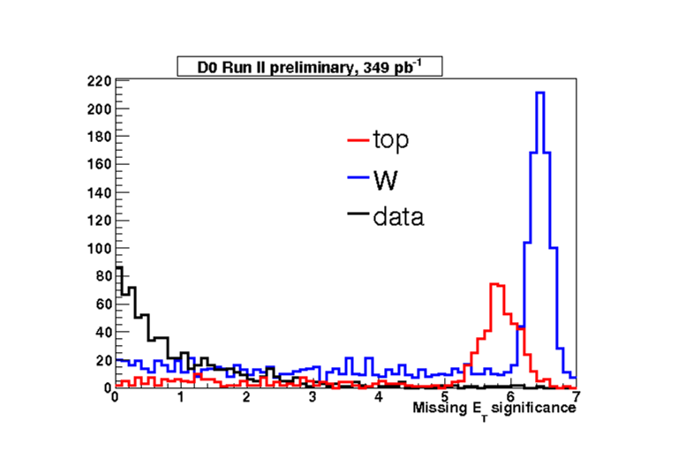
Missing E_{T} significance
significance combines the probability densities of
reconstructed physical objects (jets, electrons and unclustered
scalar energy) to give the total likelihood of physical
Excellent tool!
Probability densities of these objects are assumed to form Normal distributions, defined by the energy resolution of this object:
The probability distribution is obtained as their linear combination and is also parameterized by a Gaussian:
Thus the significance is defined as

Slide 17
Multijet QCD background
 | Loose-Tight Tau Sample 0.9>NN_{τ}>0.3 | Tight Tau Sample NN_{τ}>0.95
0 b-tags Control samples | Multijet background in control plots | Data in control plots
≥1 b-tags | Multijet background | THE selected sample
Systematic uncertainties on background model

Slide 18
Importance of τ channels
Addition of new tt modes orthogonal to explored ones. It decreases the measurement uncertainty on σ.
Crucial test of the SM prediction of lepton universality.
The results can signal new physics!
Charged Higgs search is the next logical extension of this analysis.

Slide 19
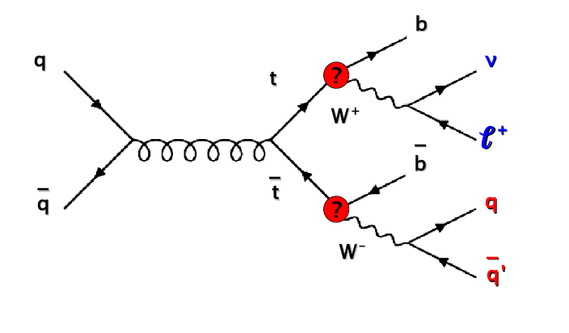
tgH⁺b
Most popular extension of the Standard Model predicts H⁺ , the Charged Higgs Boson
Like the regular neutral Higgs H⁺ prefers decay to more massive particles. It is the origin of mass after all!
And the heaviest lepton is τ !

Slide 20
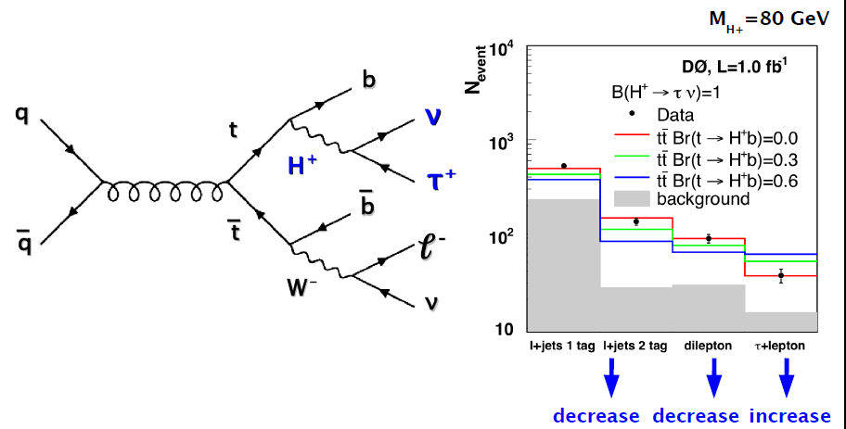
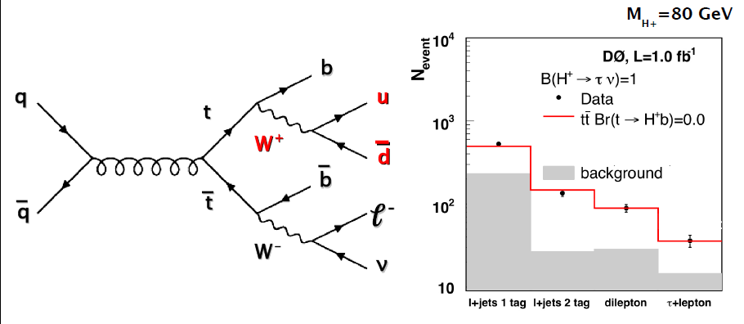
Charged Higgs search
S. Hossain’s PhD Thesis (M. Arov collaborator)

Slide 21
Conclusions
My thesis research was performed in a large (over 600 people) scientific collaboration. The top physics group itself included almost 30 members.
Due to the time and space constraints, I am not able to convey all our accomplishments over 7 years of my work in this talk.
I have demonstrated the most significant results (top decays to tau and Charged Higgs) and the most important methods (τ ID and Neural Networks) we developed.

